Slide 1
Installation Guide
(IDE – SQL Explorer Plug-in 3.5 RC6)
2008. 12.12
CODELABOR
Shin Sang Jae (codelabor@gmail.com)

Slide 2
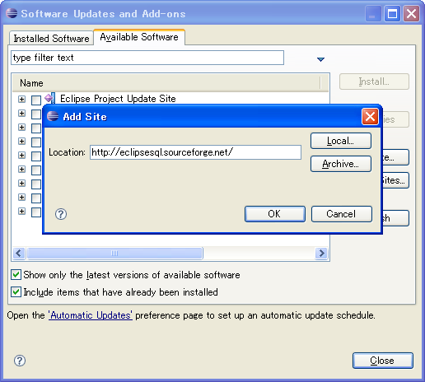
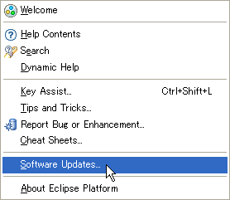
Eclipse Plug-in
Update
Eclipse Thin SQL Client plug-in
Officical Site: http://eclipsesql.sourceforge.net/
Eclipse update site URL: http://eclipsesql.sourceforge.net/

Slide 3
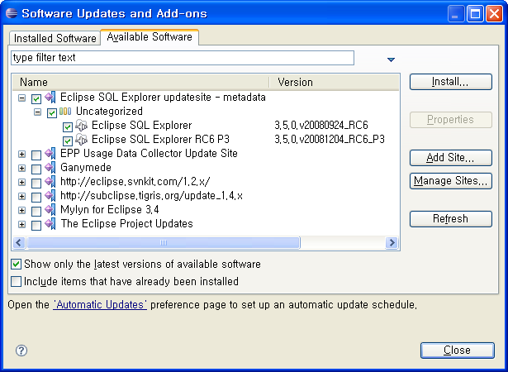
Eclipse Plug-in
Add Site
Site Location: http://eclipsesql.sourceforge.net/

Slide 4
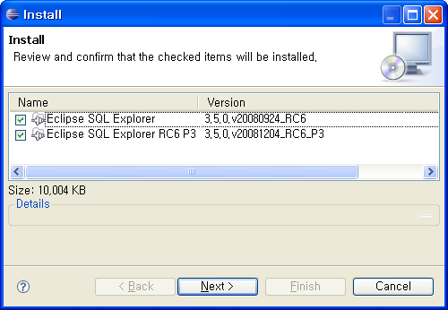
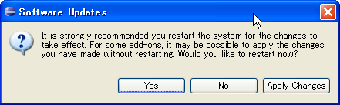
Eclipse Plug-in
Preference
Restart Eclipse or Apply Changes

Slide 5
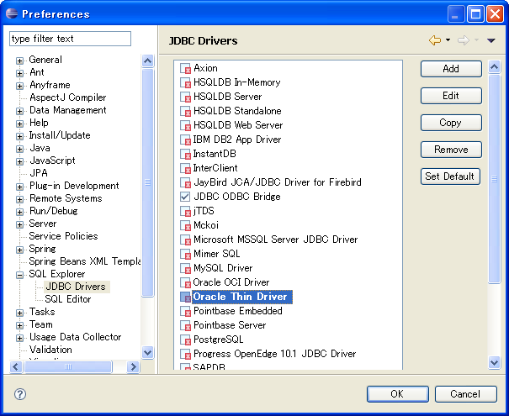
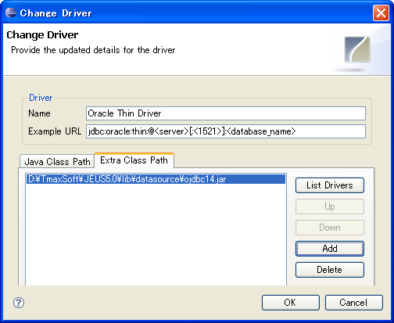
Eclipse Plug-in
Oracle JDBC Driver
Extra Class Path: C:\TmaxSoft\JEUS5.0\lib\datasource\ojdbc14.jar

Slide 6
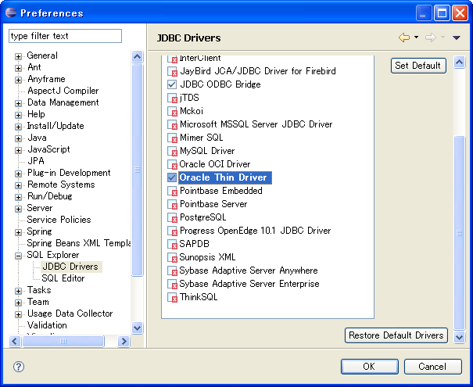
Eclipse Plug-in
Oracle JDBC Driver
Activate Oracle Thin Driver

Slide 7
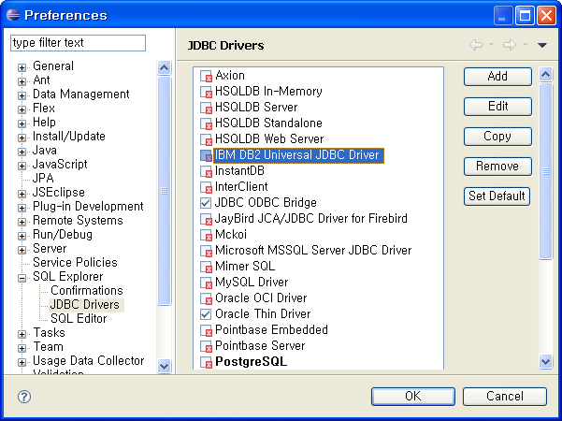
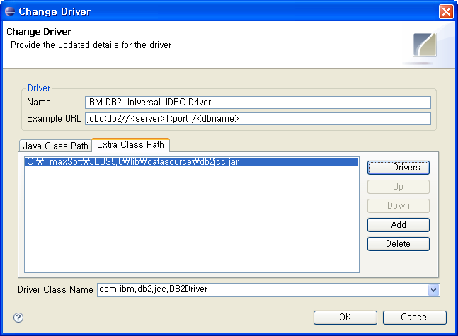
Eclipse Plug-in
DB2 JDBC Driver
Extra Class Path: C:\TmaxSoft\JEUS5.0\lib\datasource\db2jcc.jar

Slide 8
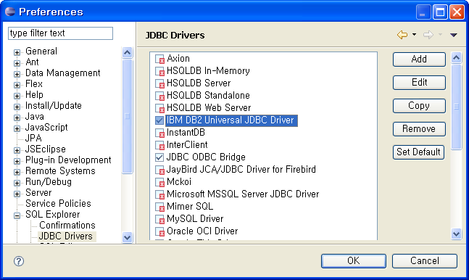
Eclipse Plug-in
DB2 JDBC Driver
Activate IBM DB2 Universal JDBC Driver
Open SQL Explorer Perspective

Slide 9
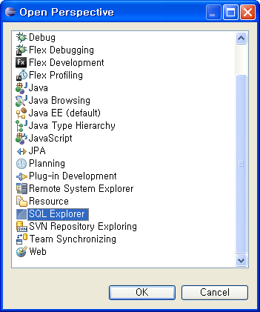
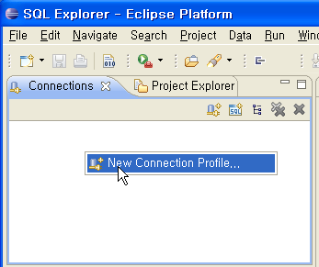
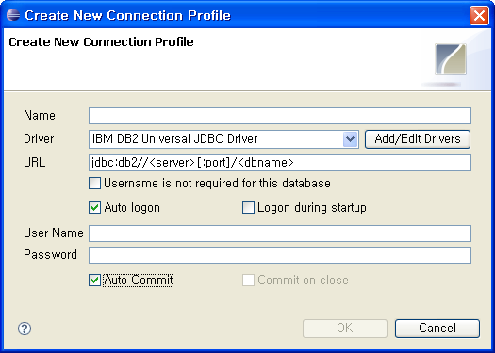
Eclipse Plug-in
Create Connection Profile
Oepn SQL Explorer Perspective
New Connection Profile
Enter URL, User Name and Password
jdbc:db2://<server>[:port]/<dbname>
is correct.

Slide 10
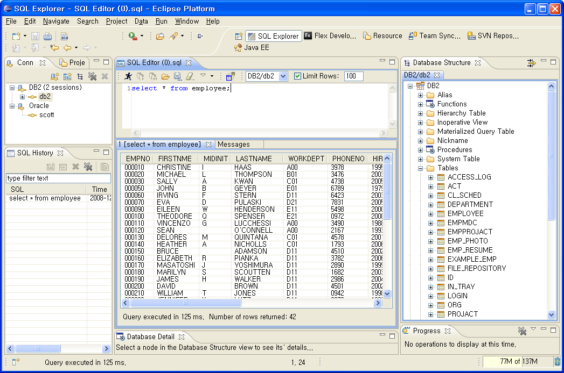
Eclipse Plug-in
Browse Table

